Slide 1
Sales Infographics
By Laila Sayed

Slide 2
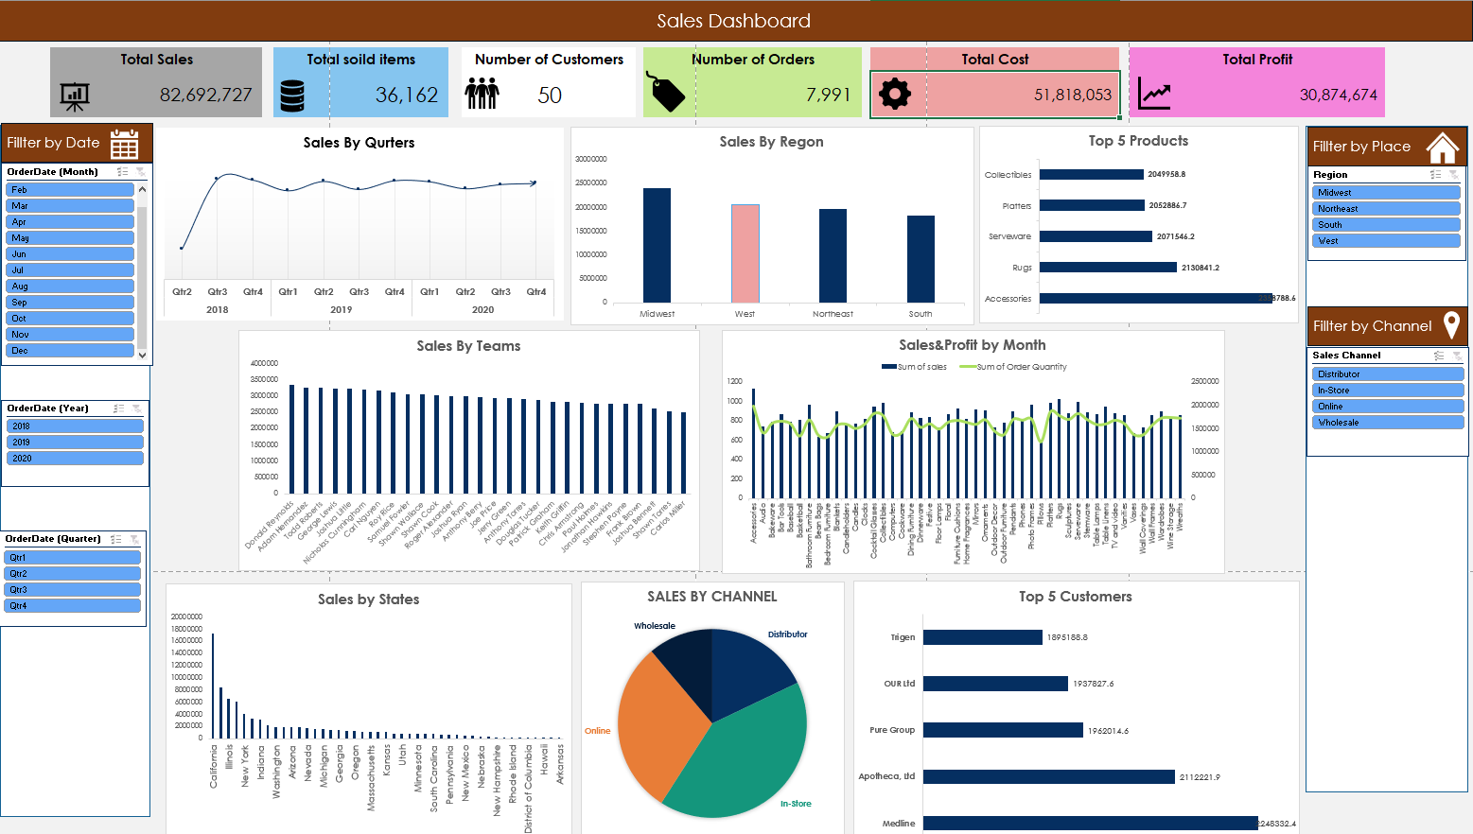

Slide 3
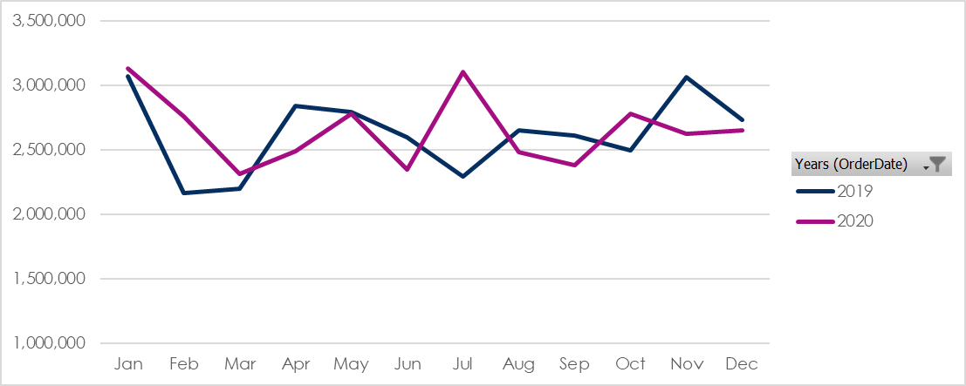
Sales by month Infographics
2020
5%
2022
14%
Note: We Don’t calculate with 2018 also because it start from Q2

Slide 4
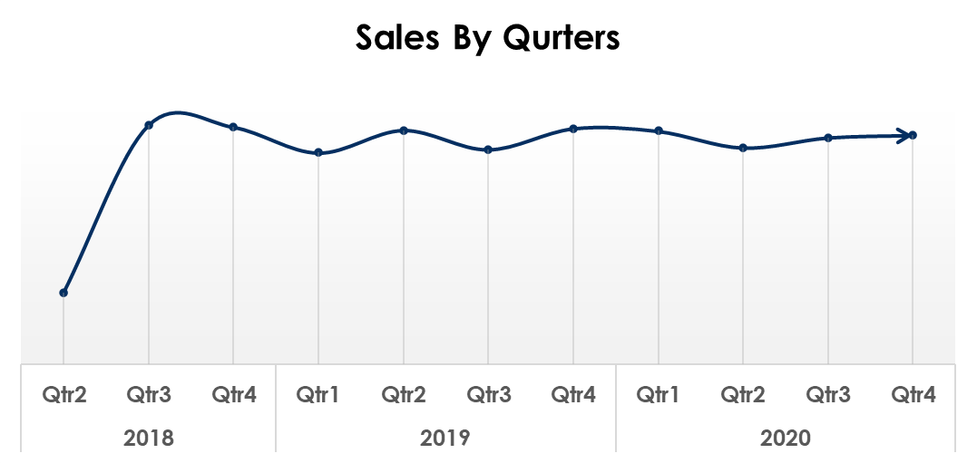
Sales by month
19,293,494
2018
31,534,790
2019
31,864,443
2020
Total Groth Margen
+ 37%

Slide 5


Business 2018 annual report infographics
Q1 | Q2 | Q3 | Q4 | 2018
- | 2,530,382 | 8,415,167 | 8,347,945 |  | Total Sales
- | 1,602,162 | 5,286,166 | 5,267,051 |  | Total Cost
- | 928,220 | 3,129,001 | 3,080,895 |  | Total profit
- | 260 | 794 | 782 |  | Number of orders
- | 2,250 | 3,705 | 3,626 |  | Total sold Items

Slide 6
Business 2019 annual report infographics
Q1 | Q2 | Q3 | Q4 | 2019
7,443,191 | 8,237,101 | 7,558,632 | 8,295,866 |  | Total Sales
4,637,135 | 5,158,806 | 4,705,040 | 5,172,737 |  | Total Cost
2,806,056 | 3,078,294 | 2,853,592 | 3,123,129 |  | Total profit
738 | 793 | 751 | 784 |  | Number of orders
3,255 | 3,568 | 3,352 | 3,462 |  | Total sold Items

Slide 7
Business 2020 annual report infographics
Q1 | Q2 | Q3 | Q4 | 2020
8,206,301 | 7,620,352 | 7,975,432 | 8,062,358 |  | Total Sales
5,157,108 | 4,715,915 | 4,995,233 | 5,120,698 |  | Total Cost
3,049,192 | 2,904,437 | 2,980,199 | 2,941,659 |  | Total profit
782 | 770 | 786 | 787 |  | Number of orders
3,541 | 3,358 | 3,491 | 3,653 |  | Total sold Items

Slide 8
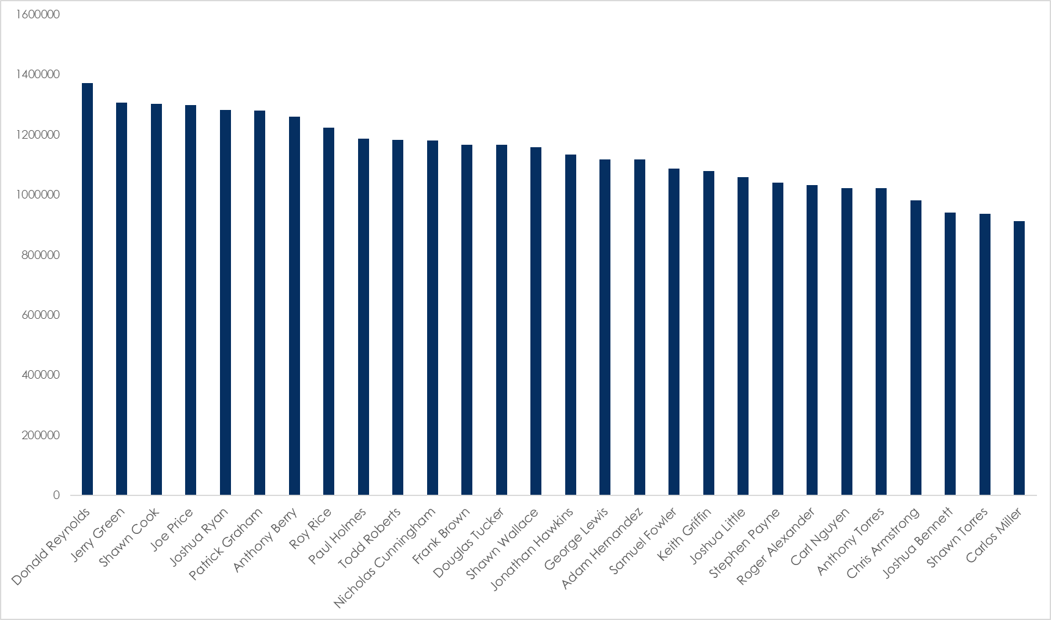
Sales by Teams
Best Teams
Donald Reynolds
1,372,106
Jerry Green
1,307,397
Shawn Cook
1,302,794

Slide 9
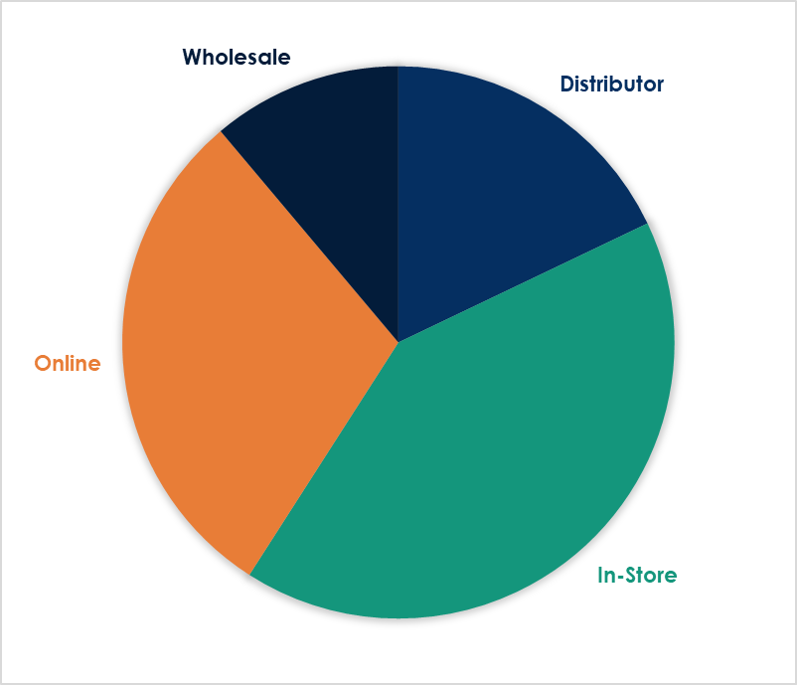
Sales by Channel
30%
11%
Wholesale
Online
Sales = 9,212,949
Sales = 24,629,756
18%
41%
Distributor
In-Store
Sales = 14,809,907
Sales = 34,040,114

Slide 10
Sales by month For 2018
2018 Sales by month
January | - | July | 2,707,550
February | - | August | 2,909,421
March | - | September | 2,798,195
April | - | October | 2,323,721
May | 75,630 | November | 2,977,607
June | 2,454,753 | December | 3,046,617

Slide 11
Sales by month For 2019
2019 Sales by month
January | 3,075,112 | July | 2,295,286
February | 2,168,569 | August | 2,652,919
March | 2,199,510 | September | 2,610,427
April | 2,844,988 | October | 2,496,795
May | 2,795,126 | November | 3,065,719
June | 2,596,987 | December | 2,733,352

Slide 12
Sales by month For 2020
2020 Sales by month
January | 3,129,999 | July | 3,108,043
February | 2,762,182 | August | 2,486,759
March | 2,314,120 | September | 2,380,631
April | 2,489,539 | October | 2,778,718
May | 2,781,726 | November | 2,629,475
June | 2,349,087 | December | 2,654,165

Slide 13
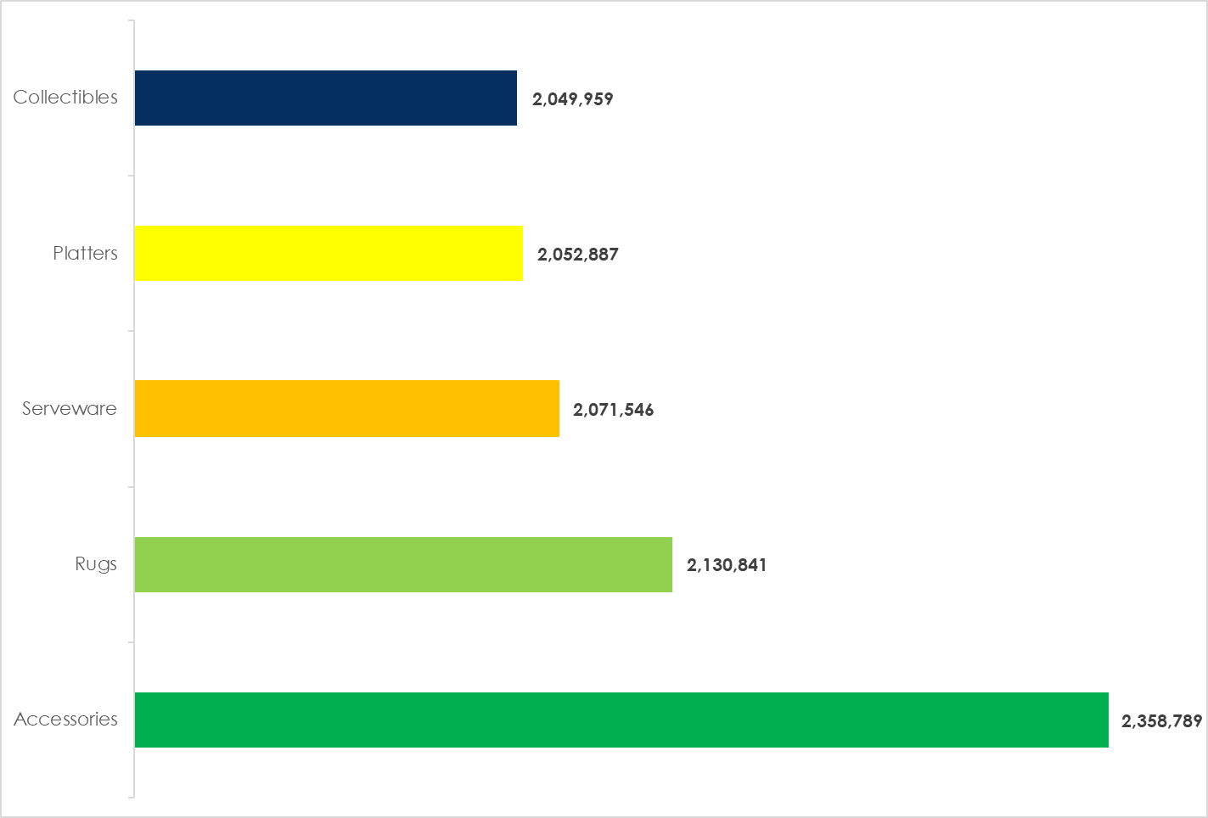
Top 5 Products
Accessories
Serveware
725,268
2,071,546
Rugs
Platters
2,130,841
2,052,887
Collectibles
2,049,959

Slide 14
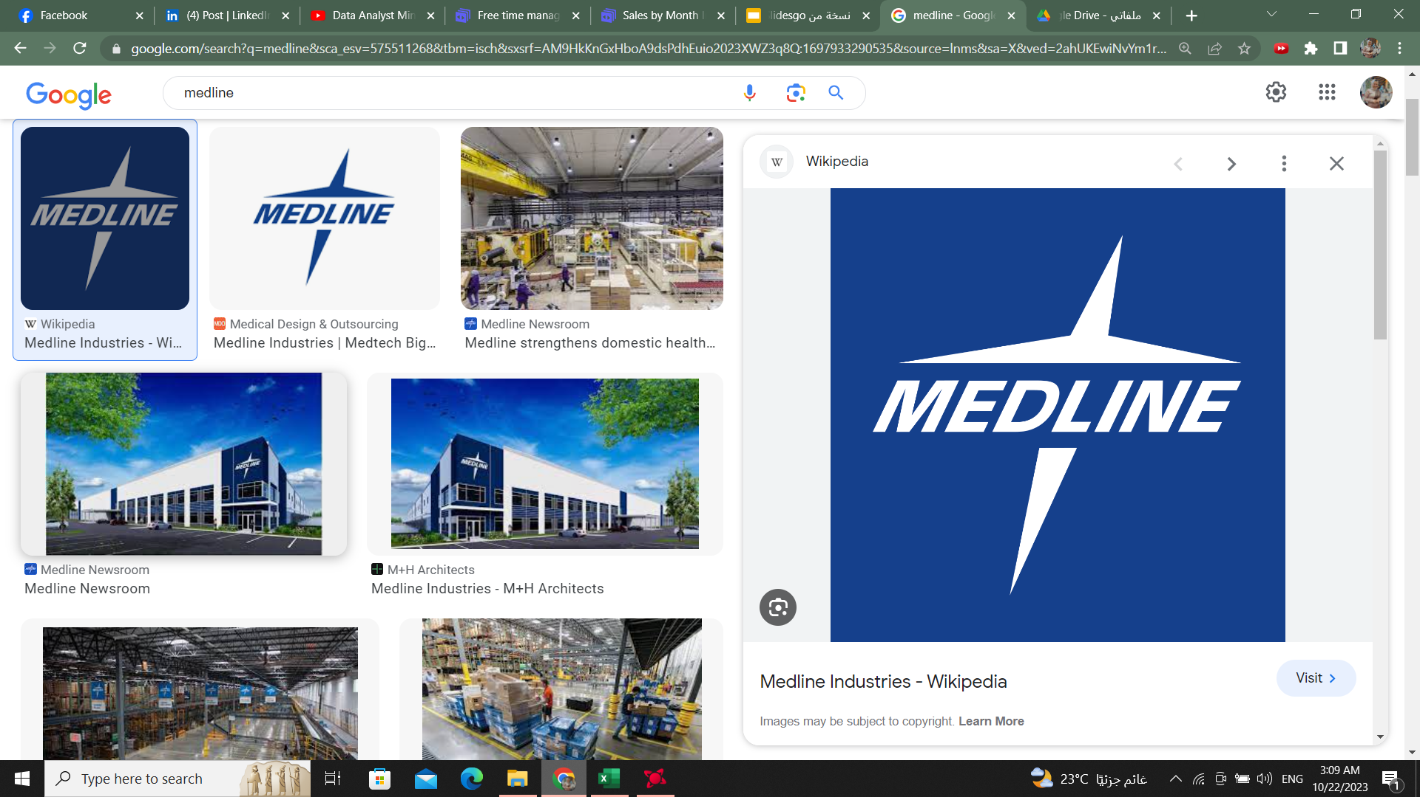
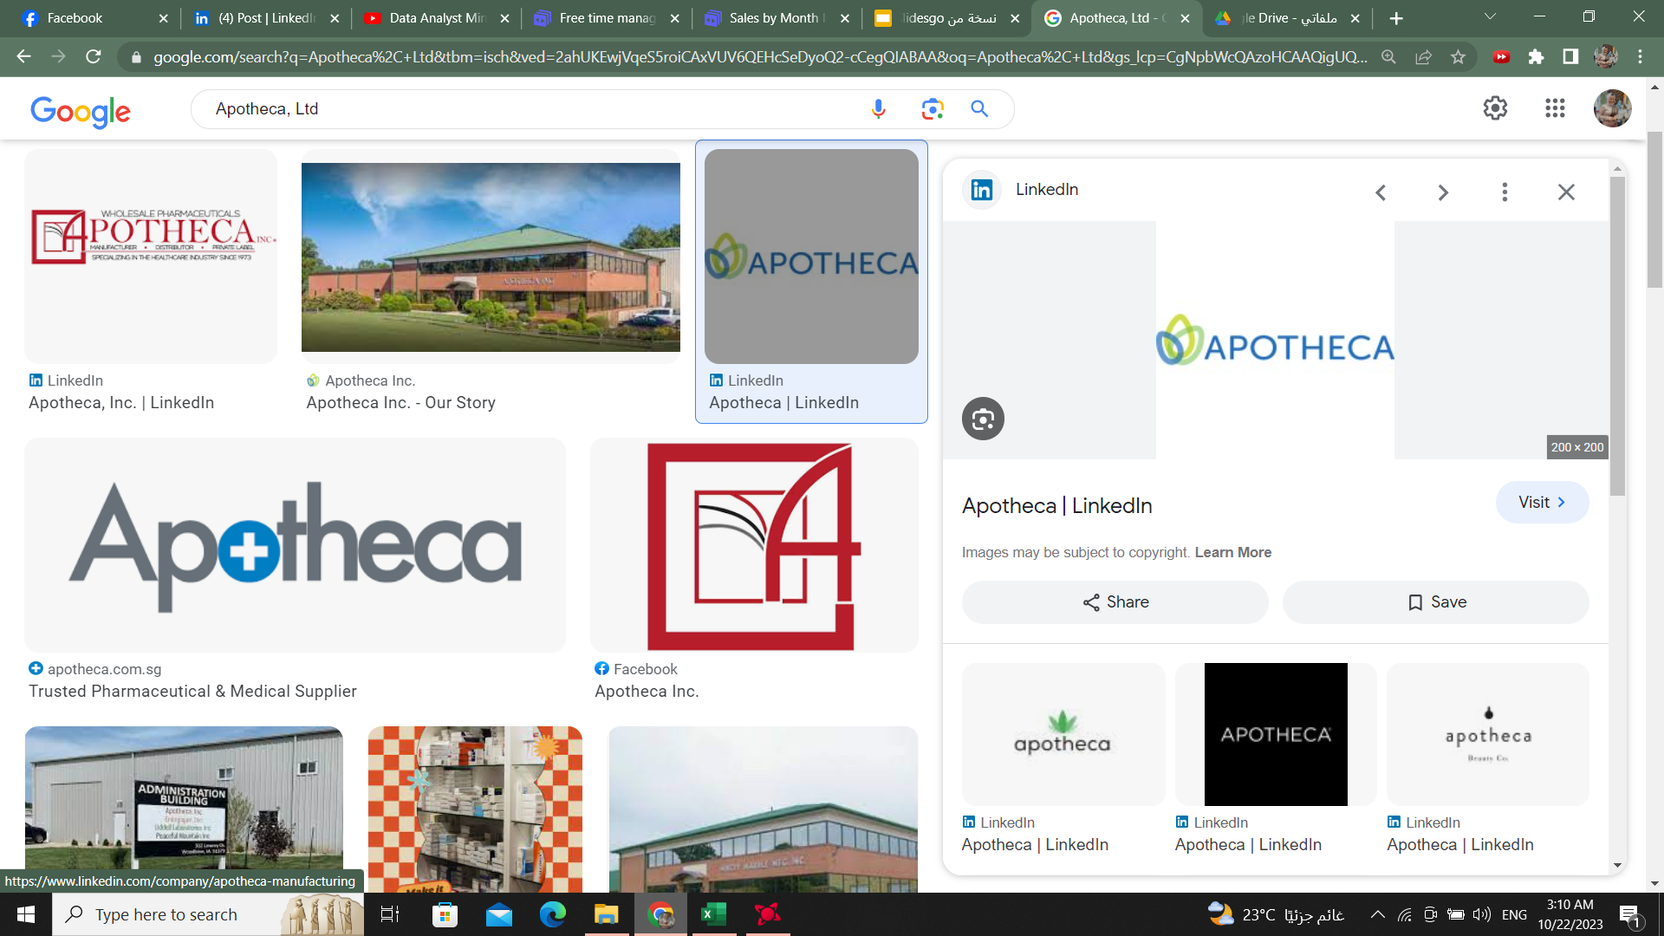
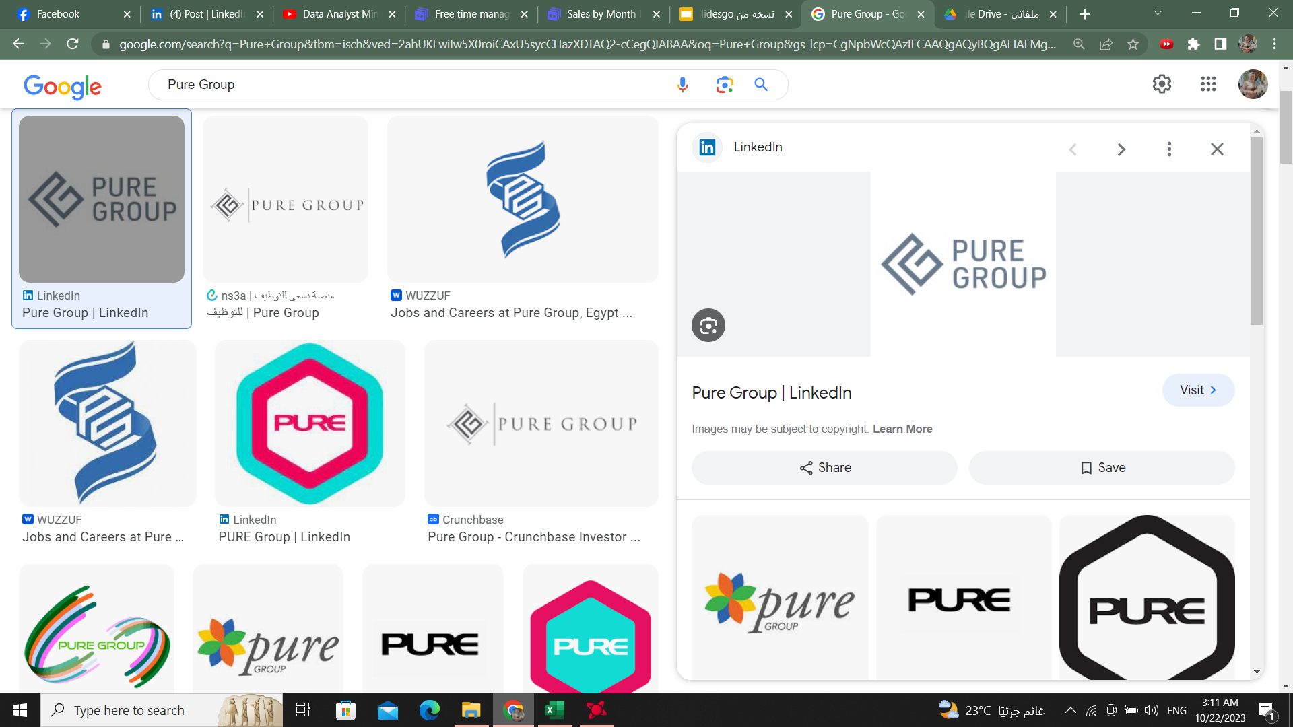
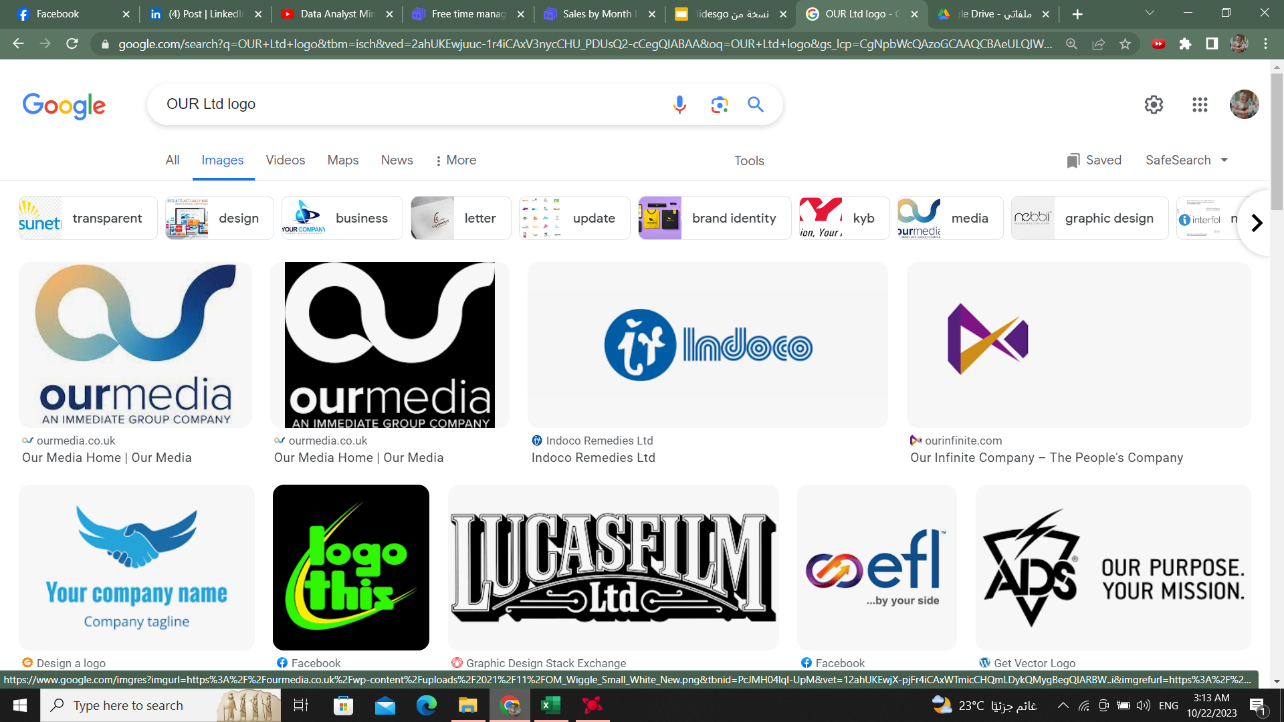
Top 4 Customers
Customer
Over 3 Years
Medline
Apotheca, Ltd
Pure Group
OUR Ltd
From North Carolina
2,112,222
From Oregon
1,962,015
From Iowa
1,937,828
From Indiana
2,248,332

Slide 15
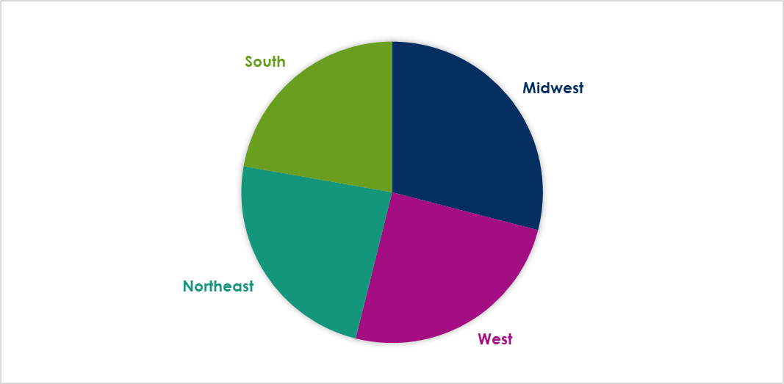
Sales By Region
World Map
sales
24%
29 %
25%
22%

Slide 16
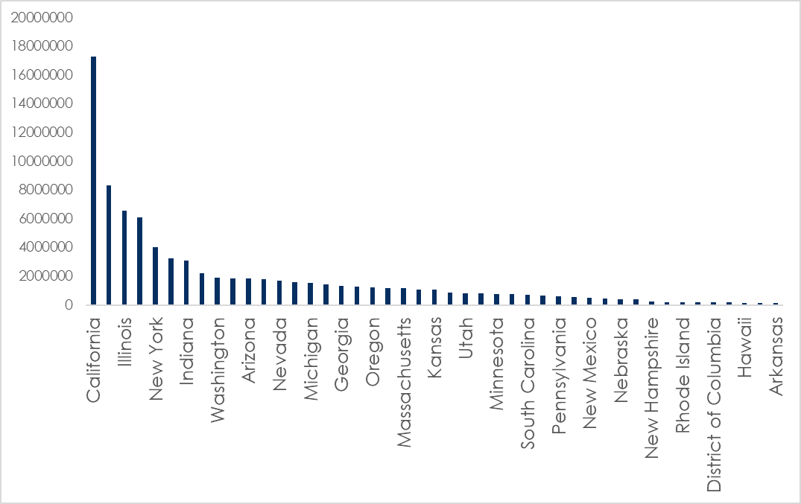
Sales by State

Slide 17
Top States over 3 Years
 | 2018 | 2019 | 2020 | Total
California | 4,271,531 | 6,114,594 | 6,897,322 | 17,283,447
Illinois | 1,594,245 | 2,603,526 | 2,345,670 | 6,543,441
New York | 708,163 | 1,564,671 | 1,762,154 | 4,034,988
Indiana | 794,171 | 1,114,920 | 1,178,376 | 3,087,467
Washington | 496,544 | 761,140 | 641,887 | 1,899,751

